Slide 1
Our Application
Null(y)

Slide 2
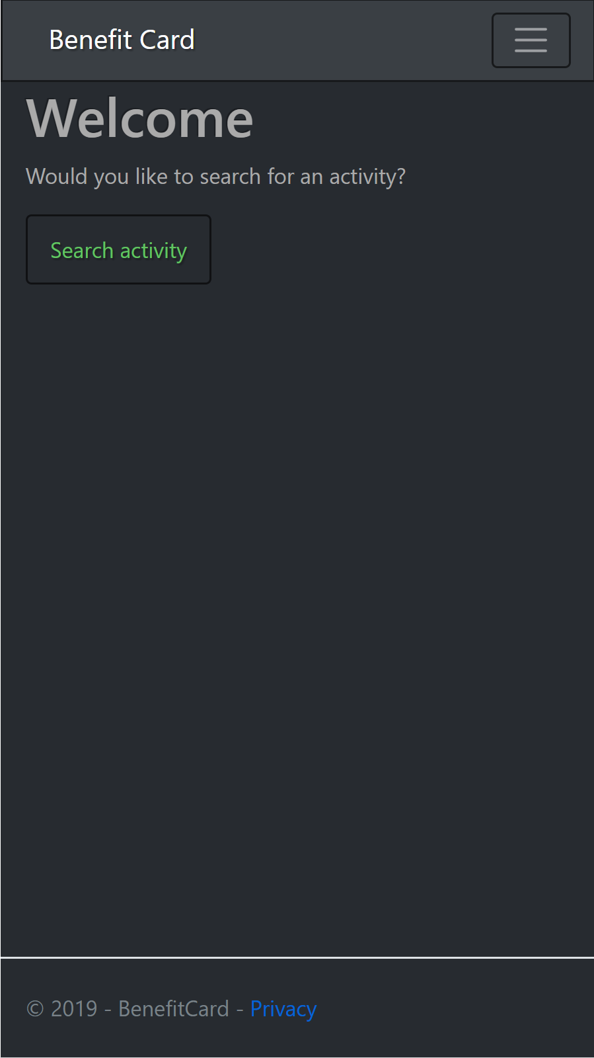
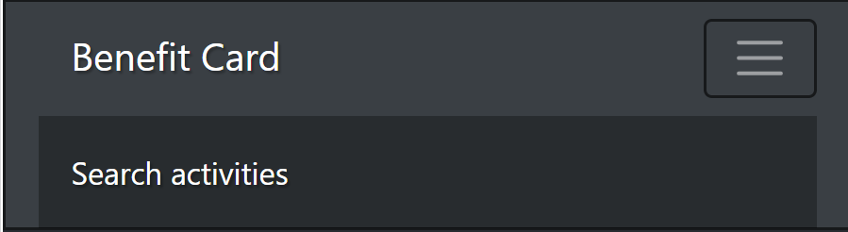
Main Window
Place for future features
Expandable menu
Simple design

Slide 3
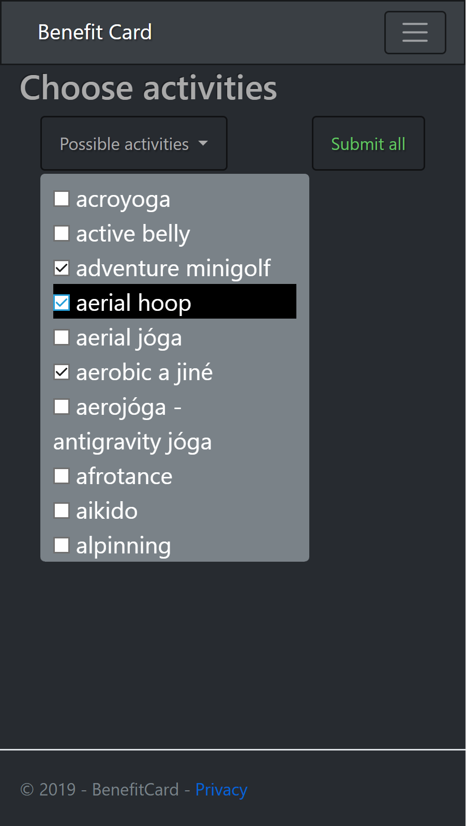
Choose activity
Scrollable checkbox menu
Dummy proof

Slide 4
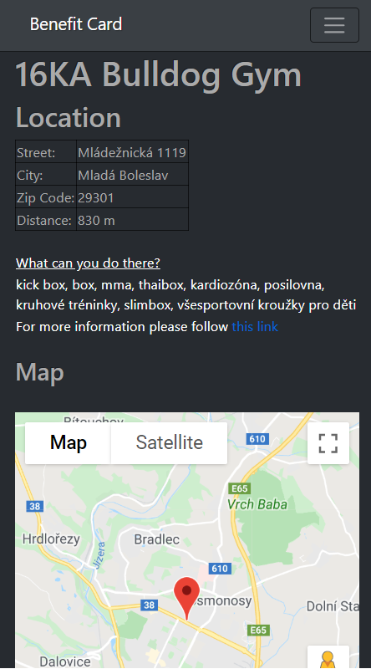
Look at detail
Detail about place
Link to web-site
Interactive google map

Slide 5
Future
Sort by distance
Personalization with user accounts
Easy to add new features

Slide 6
Potencial risks
Correctness of data
String injections
Slow connection – not optimalized (yet)

Slide 7
Thank you for your attention

